Slide 1
Introduction to Deep Learning and TensorFlow
Developed by Titus Tang 2020

Slide 2
Workshop Itinerary
Time | Event
09:00 – 09:15 | Arrival and setup
09:15 – 10:15 | Lecture 1 – Introduction to Deep Learning
10:15 – 10:30 | Break
10:30 – 11:30 | Workshop 1 - Introduction to Deep Learning
11:30 – 11:45 | Break
11:45 – 12:45 | Lecture 2 – Convolutional Neural Networks
12:45 – 13:00 | Break
13:00 – 14:00 | Workshop 2 – Convolutional Neural Networks
14:00 – 14:30 | Question session

Slide 3
Workshop Content – Part 1
Learn what is deep learning and how it works.
Learn how to use TensorFlow v2 to build a simple neural network.
Train and test our neural network.
Extend and explore the capabilities of the neural network.

Slide 4
Workshop Content – Part 2
Learn about convolutional neural networks and how they work.
Build a conv-net using TensorFlow.
Train and test our conv-net using a dataset of images.
Explore the behaviour and capabilities of our conv-net.

Slide 5
Assumed Knowledge
Basic math and calculus.
Basic Python programming skills.

Slide 6


vs
How would you traditionally design code that categorises images of dogs and cats?

Slide 7
vs
Traditional software development
Software v1
New data
Observe data
Identify features
Hand-code features
Deploy Algorithm

Slide 8
vs
Traditional software development
Software v1
New data
Observe data
Identify features
Hand-code features
Deploy Algorithm
Deep Learning
New data
Software v2
Collect data
Label data
Neural Network
Deploy Model

Slide 9
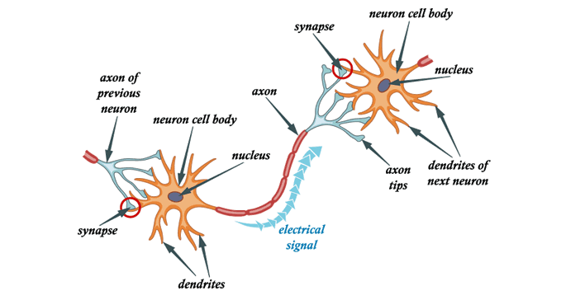
The Artificial Neural Network
Modelled after the brain.
Each neuron takes input from multiple sources.
Neuron aggregates information and passes output to next layer.
Fundamental unit – an artificial neuron, a perceptron.

Slide 10

Modelling a perceptron
Input 1
W1
+
Output
In matrix form
Input 2
W2

Slide 11
Training a perceptron
Input 1
W1
Calculate the difference between the label (truth) and the output.
This is the loss.
Adjust the weights (behaviour) so that the output equals the label.
You are minimising the loss.
+
Output
Label
Input 2
W2
-
Loss

Slide 12
Training a perceptron
0.7
Input 1
W1
The weights represent “trust” for each input.
A negative weight means to take the opposite of the input.
The loss is used to update the weights W1 and W2.
How do you change the weights to minimise the loss?
0.8
0.56+(-0.12) = 0.44
+
Output
Label
W2
1.0
Input 2
-
0.4
-0.3
Loss
0.56

Slide 13
Gradient Descent
Loss
Weight value

Slide 14




Backpropagation using Gradient Descent
Tweak the weights one by one to see which change reduces the loss.
Essentially finding the rate of change of the loss with respect to a weight.
Toy loss function:
You want to move in the direction of decreasing gradient, hence gradient descent.
Therefore
L = Learning rate

Slide 15
Backpropagation using Gradient Descent
0.7 -> 0.78
0.56+(-0.12) = 0.44
0.624+(-0.104) = 0.52
0.8
Input 1
W1
+
Output
Label
1.0
0.4
Input 2
W2
-
-0.3 -> -0.26
Loss
0.56 -> 0.48
Learning rate
0.1
Loss has reduced from 0.56 to 0.48

Slide 16

Adding a Bias
Input 1
W1
+
Output
In matrix form
Input 2
W2
Bias

Slide 17

Multilayer Perceptron
...
N11
W11
W12
N21
W21
In matrix form
...
N12
W22
N22
W31
N13
W32
# of inputs
# of nodes

